Slide 1
Lecture 6 – Threats, Risks and Attacks
COM744: Security and Risk Management
Nigel Houlden / Denise Oram
n.houlden@glyndwr.ac.uk / d.oram@Glyndwr.ac.uk

Slide 2
What Is Computer Security?
The protection of the assets of a computer system
Hardware
Software
Data

Slide 3
NIST Computer Security definition
“The protection afforded to an automated information system in order to attain the applicable objectives of preserving the integrity, availability and confidentiality of information system resources” (includes hardware, software, firmware, information/data, and telecommunications).

Slide 4
Identifying Threats
There is an almost infinite possibility of threats.
Need to accurately identify relevant threats (A structured approach is needed)
Focused on Assets
Focused on Attackers
Focused on Software

Slide 5
Focused on Assets
This method uses asset valuation and attempts to identify threats to the valuable assets.
Quantitative and Qualitative methods

Slide 6
Focused on Attackers
Identify attackers based on the threats they represent based on the attacker’s goals.
Problem – New attackers may have different goals
Governments can identify potential attackers
Threats from other governments

Slide 7
Focused on Software
If an organization develops software, it can consider potential threats against the software.
Most organizations have a web presence, and many create their own web pages.
Complex, eye catching web pages drive more traffic, but they also require more sophisticated programming and present additional threats.

Slide 8
S.T.R.I.D.E
Microsoft developed a threat categorization scheme known as STRIDE
Often used in relation to assessing threats against applications or operating systems
Spoofing
Tampering
Repudiation
Information disclosure
Denial of service (DoS)
Elevation of privilege

Slide 9
Spoofing
An attack with the goal of gaining access to a target system through the use of a falsified identity.
Spoofing can be used against:
IP addresses,
MAC address,
usernames,
system names,
wireless network SSIDs,
email addresses,
and many other types of logical identification.
When an attacker spoofs their identity as a valid or authorized entity, they are often able to bypass filters and blockades against unauthorised access.

Slide 10
Tampering
Any action resulting in the unauthorised changes or manipulation of data, whether in transit or in storage.
Tampering is used to falsify communications or alter static information.
Such attacks are a violation of integrity as well as availability.

Slide 11
Repudiation
The ability for a user or attacker to deny having performed an action or activity.
Often attackers engage in repudiation attacks in order to maintain plausible deniability so as not to be held accountable for their actions.
Repudiation attacks can also result in innocent third parties being blamed for security violations.

Slide 12
Information disclosure
The revelation or distribution of private, confidential, or controlled information to external or unauthorised entities.
This could include customer identity information, financial information, or proprietary business operation details.
Information disclosure can take advantage of system design and implementation mistakes
Failing to remove debugging code
Leaving sample applications
Test accounts

Slide 13
Denial of service (DoS)
An attack that attempts to prevent authorised / legitimate use of a resource.
This can be done through flaw exploitation, connection overloading, or traffic flooding.
A DoS attack does not necessarily result in full interruption to a resource; it could instead reduce throughput or introduce latency or introduce latency in order to hamper productive use of a resource.

Slide 14
Elevation of privilege
An attack where a limited user account is transformed into an account with greater privileges.
This might be accomplished through theft or exploitation of the credentials of a higher-level account, such as that of an administrator or root.

Slide 15
S.T.R.I.D.E
STRIDE is typically used to focus on application threats, it is applicable to other situations, such as network threats and host threats.
Other attacks may be more specific to network and /or host
sniffing and hijacking for networks
malware and arbitrary code execution for hosts

Slide 16
Potential Attacks / Threats
Potential threats to a business are broad and varied.
A company faces threats from nature, technology, and people.
Most businesses focus on natural disasters and IT attacks in preparing for threats, but it’s also important to consider threat potential from individuals.

Slide 17
Potential Attacks / Threats
Once an understanding of the threats have been understood (i.e STRIDE)
Next step is to protect
we need to understand where an attack could come from.
This can be accomplished through the creation of a diagram of the elements involved in a transaction along with indications of data flow and boundaries

Slide 18
Potential Attacks / Threats
Database
Authenticate User
Login Process
Login request
Web Servlet
Authenticate User result
Users
Login response
User / Web Server Boundary

Slide 19
Computer Security Challenges
Potential attacks on the security features must be considered
Procedures used to provide particular services are often counterintuitive
Physical and logical placement needs to be determined
Additional algorithms or protocols may be involved

Slide 20
Computer Security Challenges
Attackers only need to find a single weakness, the developer needs to find all weaknesses
Users and system managers tend to not see the benefits of security until a failure occurs
Security requires regular and constant monitoring
Is often an afterthought to be incorporated into a system after the design is complete
Thought of as an impediment to efficient and user-friendly operation

Slide 21
Assets

Slide 22
Values of Assets

Slide 23
Basic Terms
Vulnerability
Threat
Attack
Countermeasure or control

Slide 24
Computer Security Terminology RFC 4949
adversary An entity that attacks a system. (Compare: cracker, intruder, hacker.) An entity that is a threat to a system.
attack An intentional act by which an entity attempts to evade security services and violate the security policy of a system. That is, an actual assault on system security that derives from an intelligent threat.
countermeasure An action, device, procedure, or technique that meets or opposes (i.e., counters) a threat, a vulnerability, or an attack by eliminating or preventing it, by minimizing the harm it can cause, or by discovering and reporting it so that corrective action can be taken.
risk An expectation of loss expressed as the probability that a particular threat will exploit a particular vulnerability with a particular harmful result.

Slide 25
Computer Security Terminology RFC 4949
security policy - A set of policy rules (or principles) that direct how a system (or an organization) provides security services to protect sensitive and critical system resources.
system resource - Data contained in an information system; or a service provided by a system; or a system capacity, such as processing power or communication bandwidth; or an item of system equipment (i.e., hardware, firmware, software, or documentation); or a facility that houses system operations and equipment.
threat - A potential for violation of security, which exists when there is an entity, circumstance, capability, action, or event that could cause harm. A threat is a possible danger that might exploit a vulnerability.
vulnerability - A flaw or weakness in a system's design, implementation, or operation and management that could be exploited to violate the system's security policy.

Slide 26
Vulnerabilities, Threats and Attacks
Categories of vulnerabilities
Corrupted (loss of integrity)
Leaky (loss of confidentiality)
Unavailable or very slow (loss of availability)
Threats
Capable of exploiting vulnerabilities
Represent potential security harm to an asset
Attacks (threats carried out)
Passive – attempt to learn or make use of information from the system that does not affect system resources
Active – attempt to alter system resources or affect their operation
Insider – initiated by an entity inside the security parameter
Outsider – initiated from outside the perimeter

Slide 27
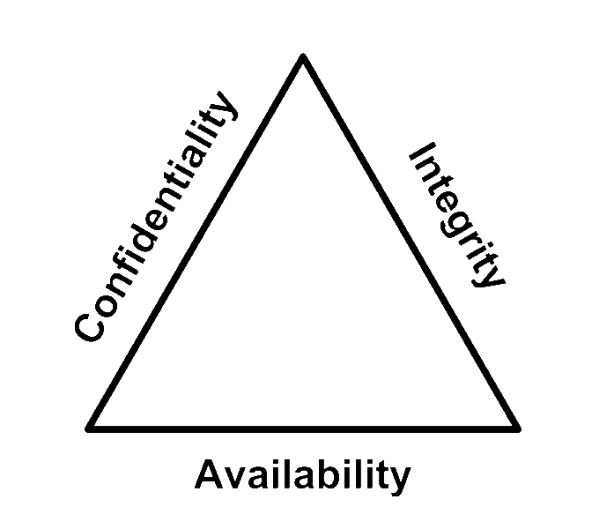
C-I-A Triad
Confidentiality
Integrity
Availability
Sometimes two other desirable characteristics:
Authentication
Nonrepudiation

Slide 28
Key Security Concepts
Confidentiality
Preserving authorised restrictions on information access and disclosure, including means for protecting personal privacy and proprietary information
Integrity
Guarding against improper information modification or destruction, including ensuring information nonrepudiation and authenticity
Availability
Ensuring timely and reliable access to and use of information

Slide 29
Access Control

Slide 30
Types of Threats

Slide 31
Assets and Threats

Slide 32
Threat consequences and actions

Slide 33
Advanced Persistent Threat (APT)
Organized
Directed
Well financed
Patient
Silent
https://en.wikipedia.org/wiki/Stuxnet

Slide 34
Types of Attackers

Slide 35
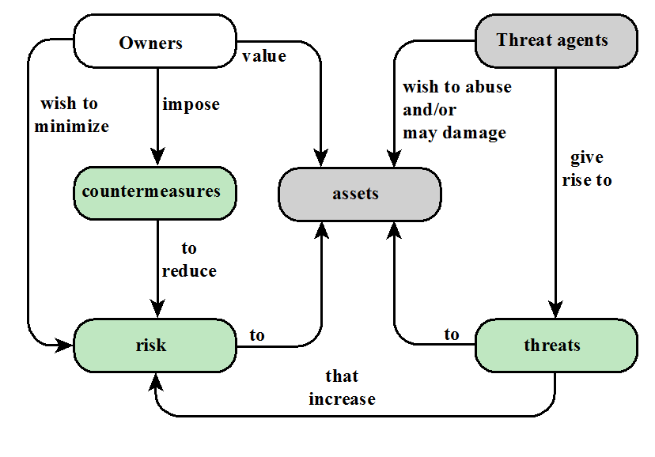
Security concepts and relationships

Slide 36
Attack Surface Categories
Network Attack Surface
Vulnerabilities over an enterprise network, wide-area network, or the Internet
Included in this category are network protocol vulnerabilities, such as those used for a denial-of-service attack, disruption of communications links, and various forms of intruder attacks
Software Attack Surface
Vulnerabilities in application, utility, or operating system code
Particular focus is Web server software
Human Attack Surface
Vulnerabilities created by personnel or outsiders, such as social engineering, human error, and trusted insiders

Slide 37
Attack Surfaces
Attack Surface Examples
Consist of the reachable and exploitable vulnerabilities in a system
Examples:
Open ports on outward facing Web and other servers, and code listening on those ports
Services available on the inside of a firewall
Code that processes incoming data, email, XML, office documents, and industry-specific custom data exchange formats
Interfaces, SQL, and Web forms
An employee with access to sensitive information vulnerable to a social engineering attack

Slide 38
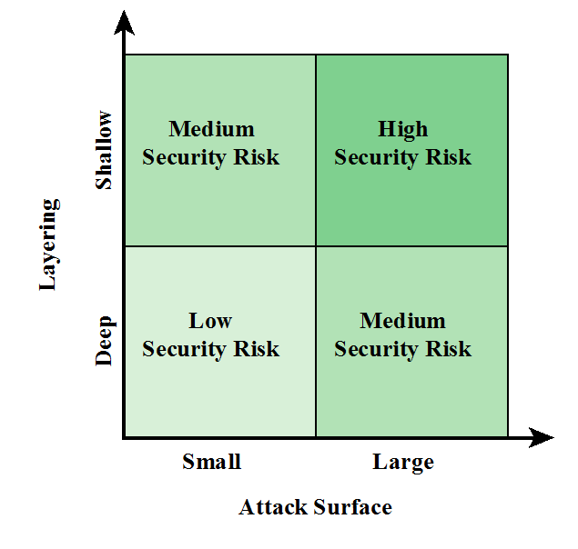
Defence in depth and attack surface

Slide 39
Passive and Active Attacks
Passive Attack | Active Attack
Attempts to learn or make use of information from the system but does not affect system resources | Attempts to alter system resources or affect their operation
Eavesdropping on, or monitoring of, transmissions | Involve some modification of the data stream or the creation of a false stream
Goal of attacker is to obtain information that is being transmitted | Four categories: Replay Masquerade Modification of messages Denial of service
Two types: Release of message contents Traffic analysis

Slide 40
Types of Harm

Slide 41
Levels of Impact
Low
The loss could be expected to have a limited adverse effect on organizational operations, organizational assets, or individuals
Moderate
The loss could be expected to have a serious adverse effect on organizational operations, organizational assets, or individuals
High
The loss could be expected to have a severe or catastrophic adverse effect on organizational operations, organizational assets, or individuals

Slide 42
 | Probability / Impact matrix
 | Impact | 5 | 4 | 3 | 2 | 1
Likelihood
5 |  | 25 | 20 | 15 | 10 | 5
4 |  | 20 | 16 | 12 | 8 | 4
3 |  | 15 | 12 | 9 | 6 | 3
2 |  | 10 | 8 | 6 | 4 | 2
1 |  | 5 | 4 | 3 | 2 | 1

Slide 43
Method—Opportunity--Motive

Slide 44
Controls/Countermeasures

Slide 45
Countermeasures
Means used to deal with security attacks
Prevent
Detect
Recover
May itself introduce new vulnerabilities
Residual vulnerabilities may remain
Goal is to minimize residual level of risk to the assets

Slide 46
Different Types of Controls

Slide 47
Computer Security Strategy
Security Policy
Formal statement of rules and practices that specify or regulate how a system or organization provides security services to protect sensitive and critical system resources
Security Implementation
Involves four complementary courses of action:
Prevention
Detection
Response
Recovery
Assurance
The degree of confidence one has that the security measures, both technical and operational, work as intended to protect the system and the information it processes
Evaluation
Process of examining a computer product or system with respect to certain criteria

